Slide 1

FINAL PROJECT DATA SCIENCE MUNICH ANSWERING QUESTIONS ABOUT SUSTAINABILITY THROUGH DATA, WITH PYTHON
Presenter: Liliani Lacerda
June/2021

Slide 2
Project Description
Application of data science methods and tools to answer the questions:
1. Are CO2 emissions and energy consumption related? 2. Has CO2 emissions reduced after the implementation of carbon tax?
Libraries Used
Pandas
Numpy
Matplotlib
Plotly
Seaborn
Datasets
Our World In Data: https://ourworldindata.org
https://taxfoundation.org/carbon-taxes-in-europe-2020/

Slide 3
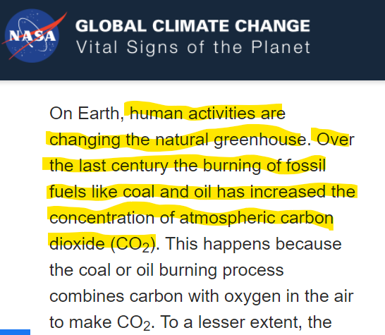

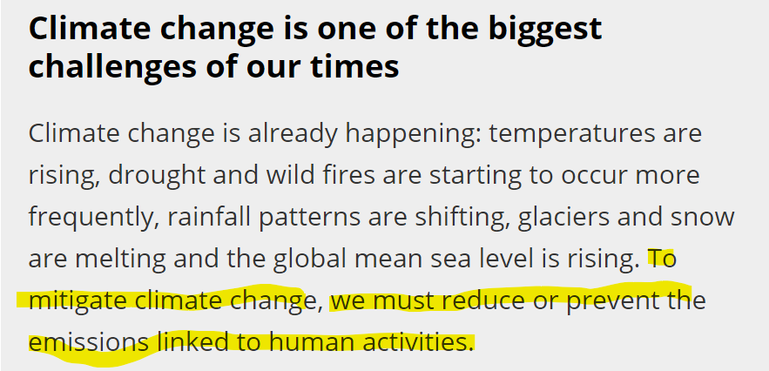
Motivation
Source: United Nation
https://www.un.org/press/en/2021/sc14445.doc.htm
Source: European Environment Agency
https://www.eea.europa.eu/themes/climate/climate-change-is-one-of

Slide 4
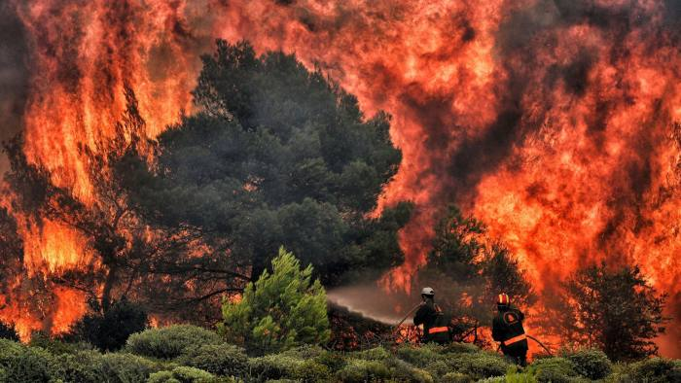



Motivation
https://www.ft.com/content/ef7b2fc8-a16f-11e9-a282-2df48f366f7d
Source: https://www.nytimes.com/2019/12/04/climate/climate-change-acceleration.html
https://www.prio.org/Events/Event/?x=8716

Slide 5
1. Are CO2 emissions and energy consumption related?

Slide 6
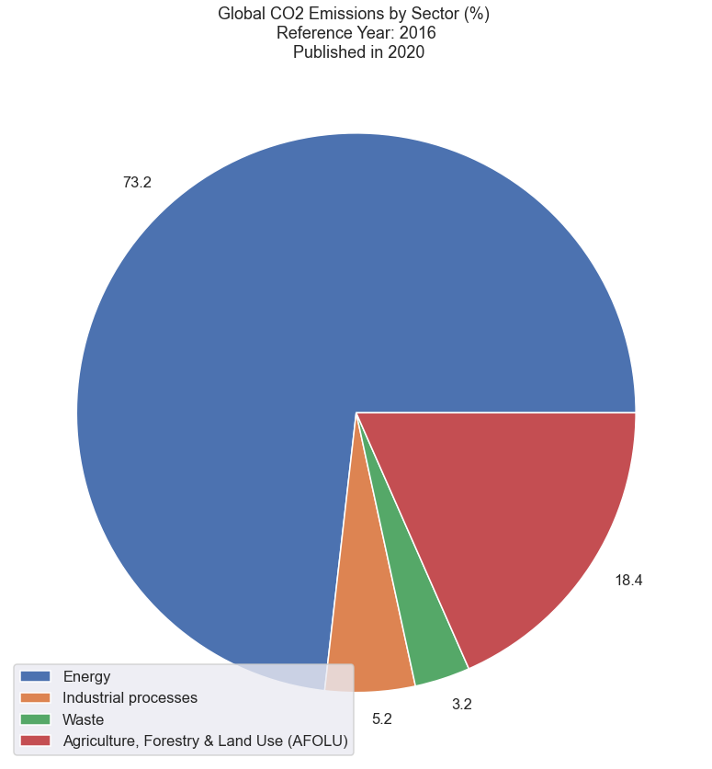
Why does it important to look at the relation between CO2 emissions and Energy Consumption?

Slide 7
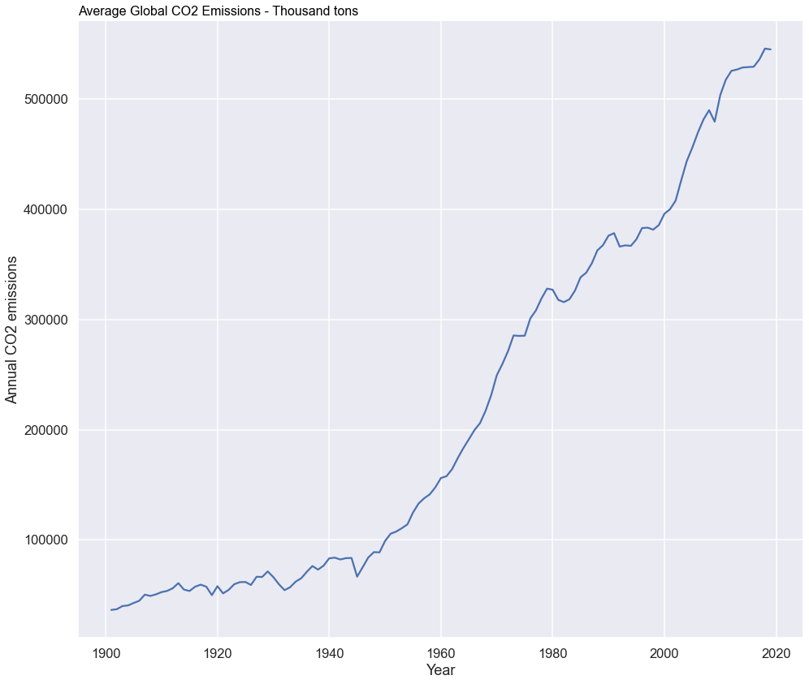
Global Average CO2 Emissions
Third Industrial Revolution
Source: https://ourworldindata.org/co2-emissions?country=

Slide 8
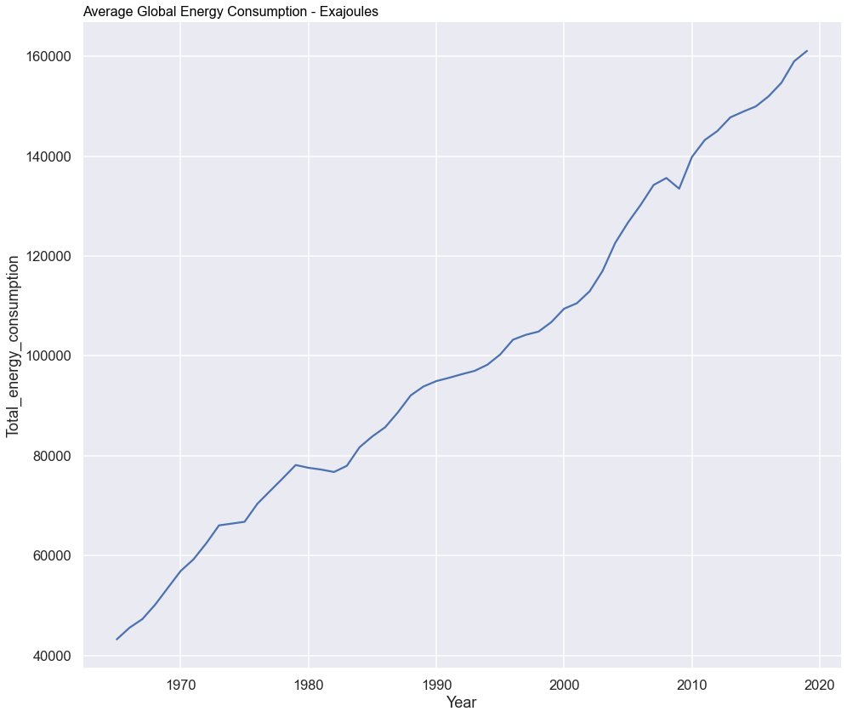
Global Average Energy Consumption
Source: https://ourworldindata.org/energy-mix?country=

Slide 10
2. Has CO2 emissions reduced after the implementation of carbon tax?

Slide 11
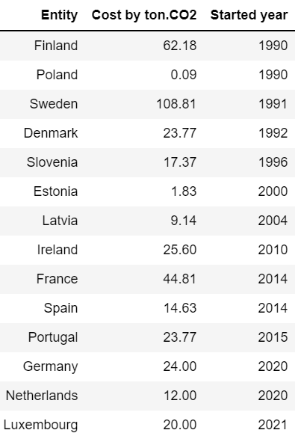
European Countries with Carbon Tax Implemented

Slide 12
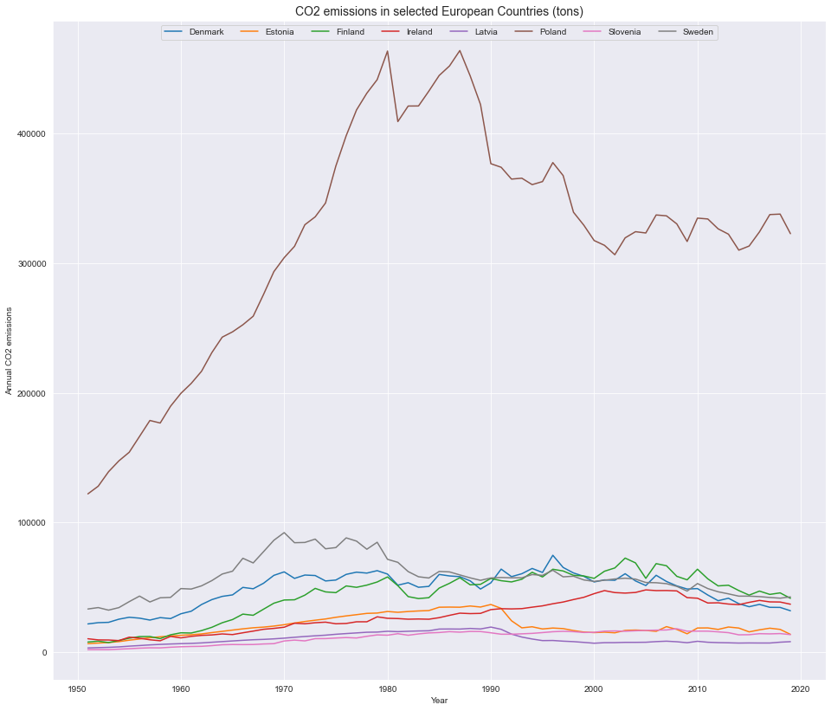
CO2 emissions in countries with Carbon Tax implemented for more than 10 years

Slide 13
Looking at CO2 Emissions and Energy Consumption by Source in each country of our list

Slide 14
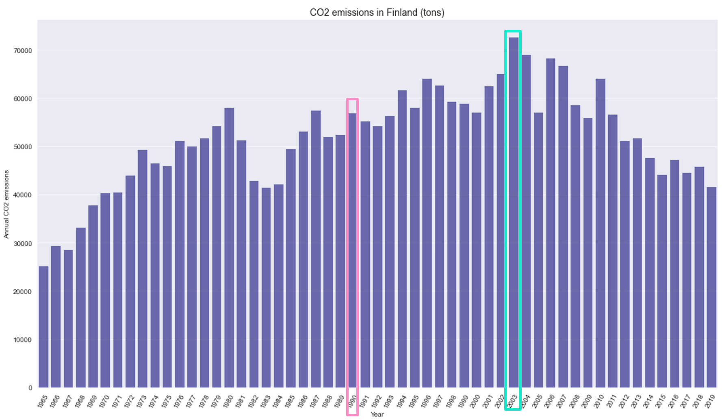
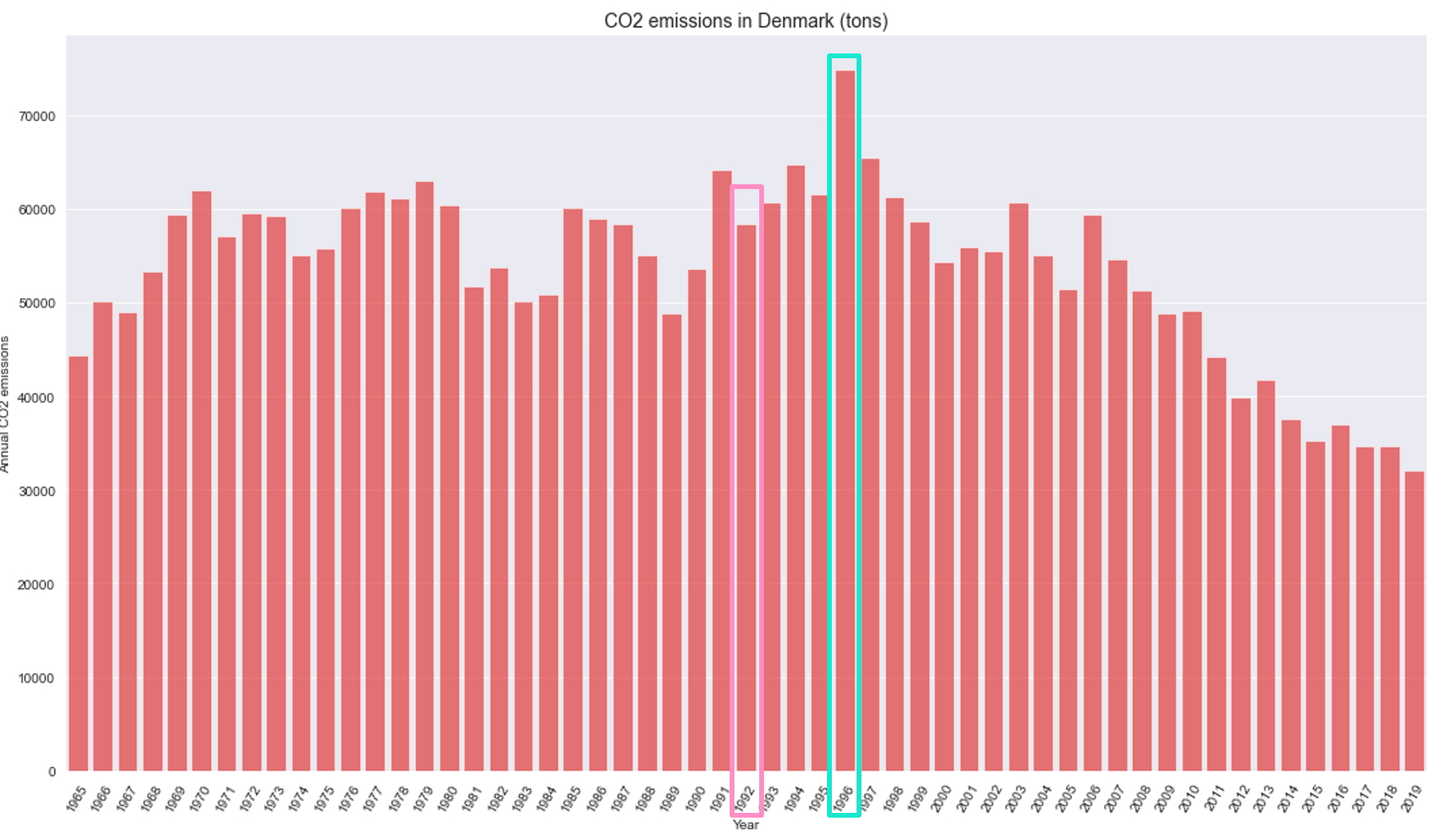
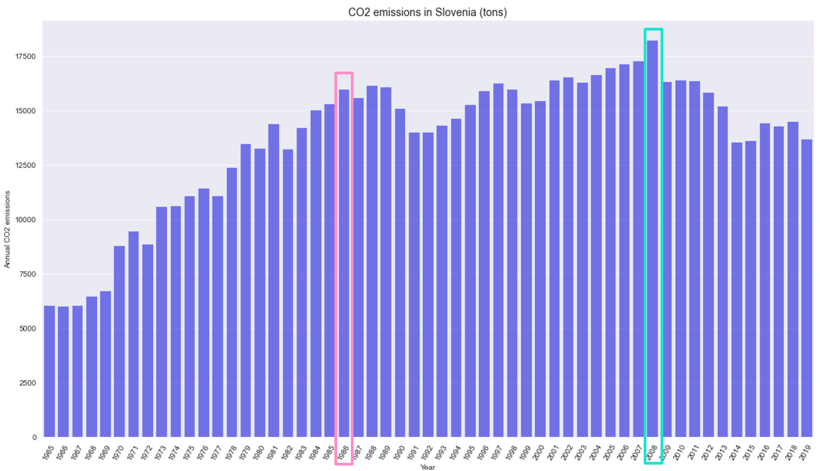
Highest CO2 emissions after Carbon Tax Implementation
Year of Carbon Tax Implementation
Year of Highest CO2 emission

Slide 15
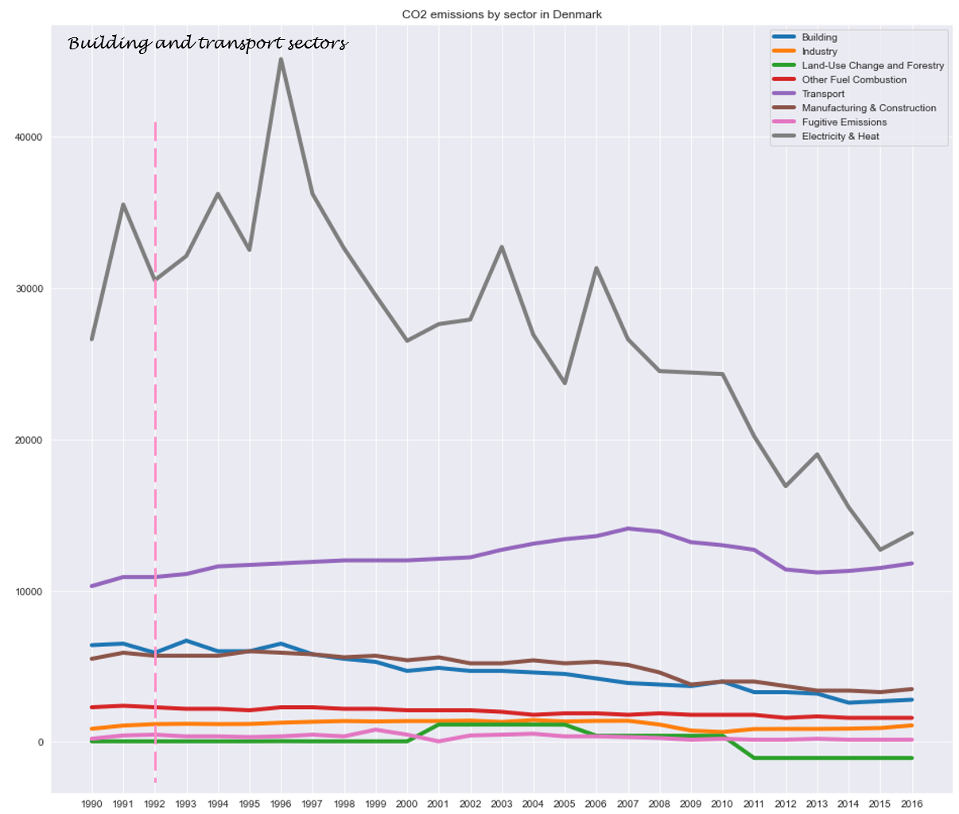
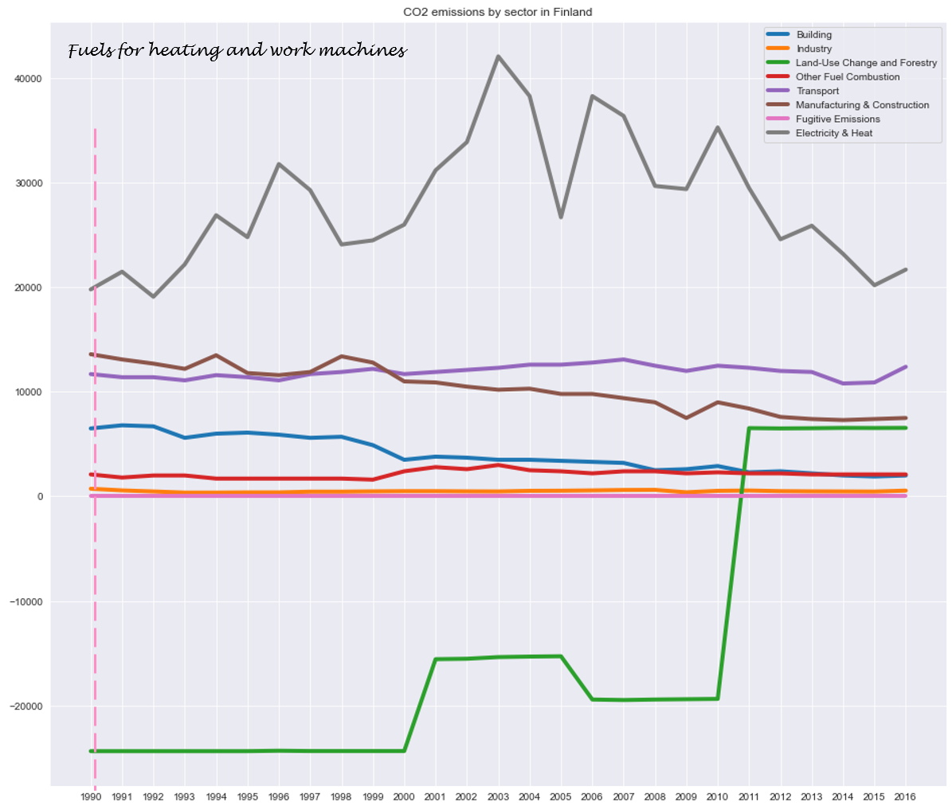
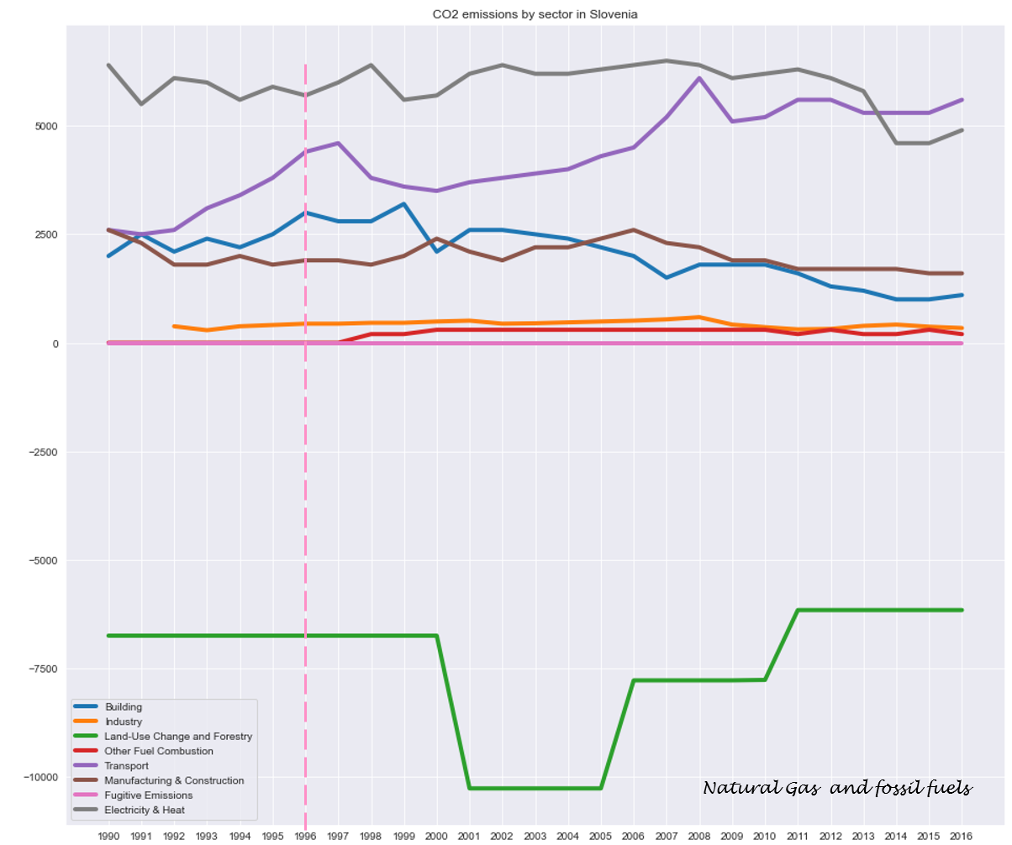
CO2 Emissions by Economic Sector

Slide 16
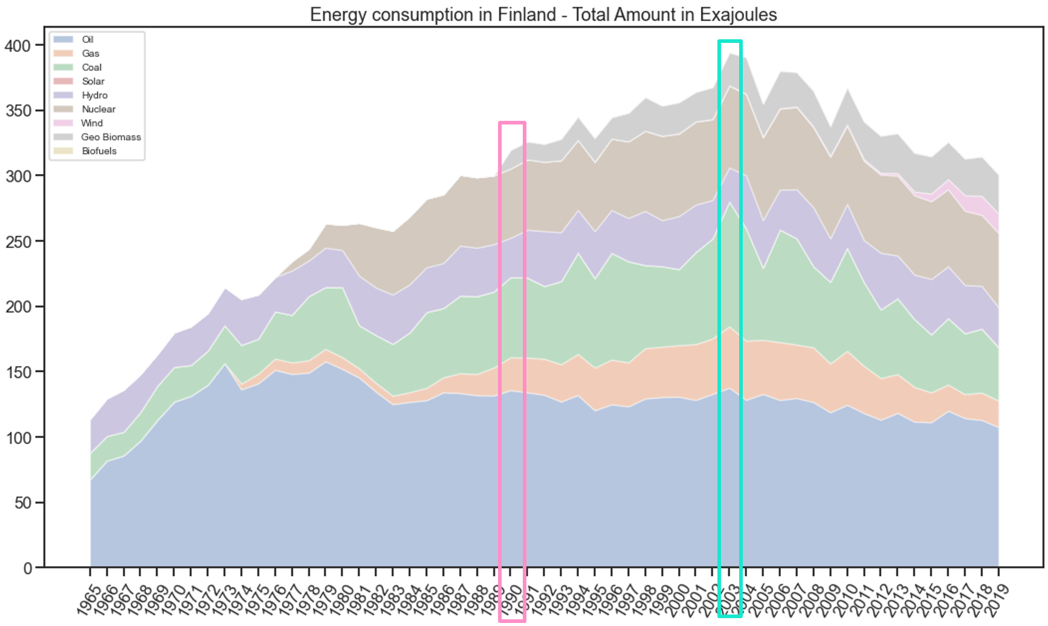
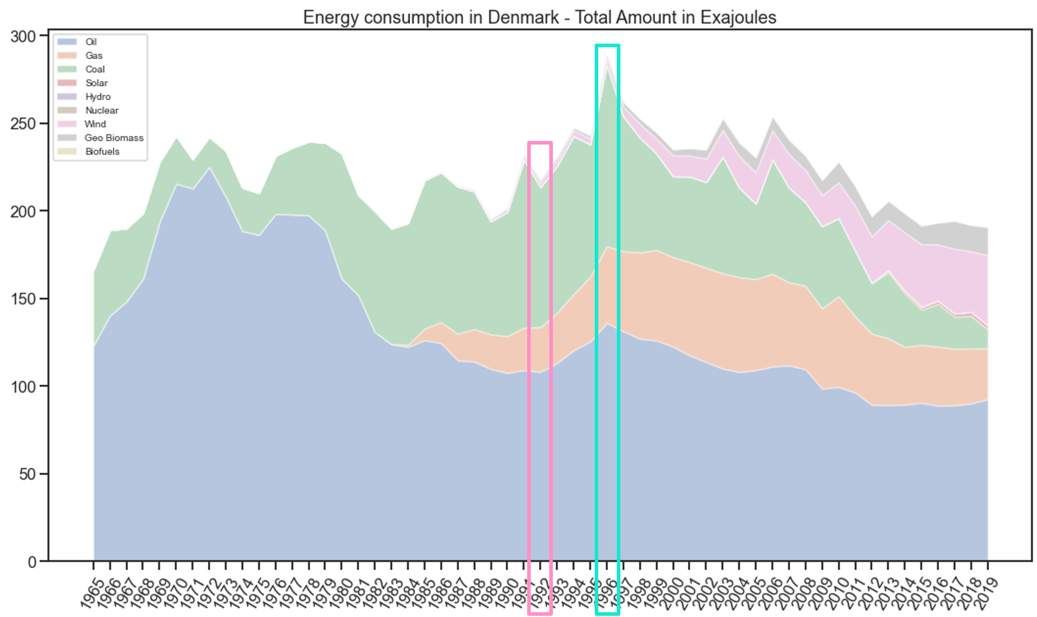
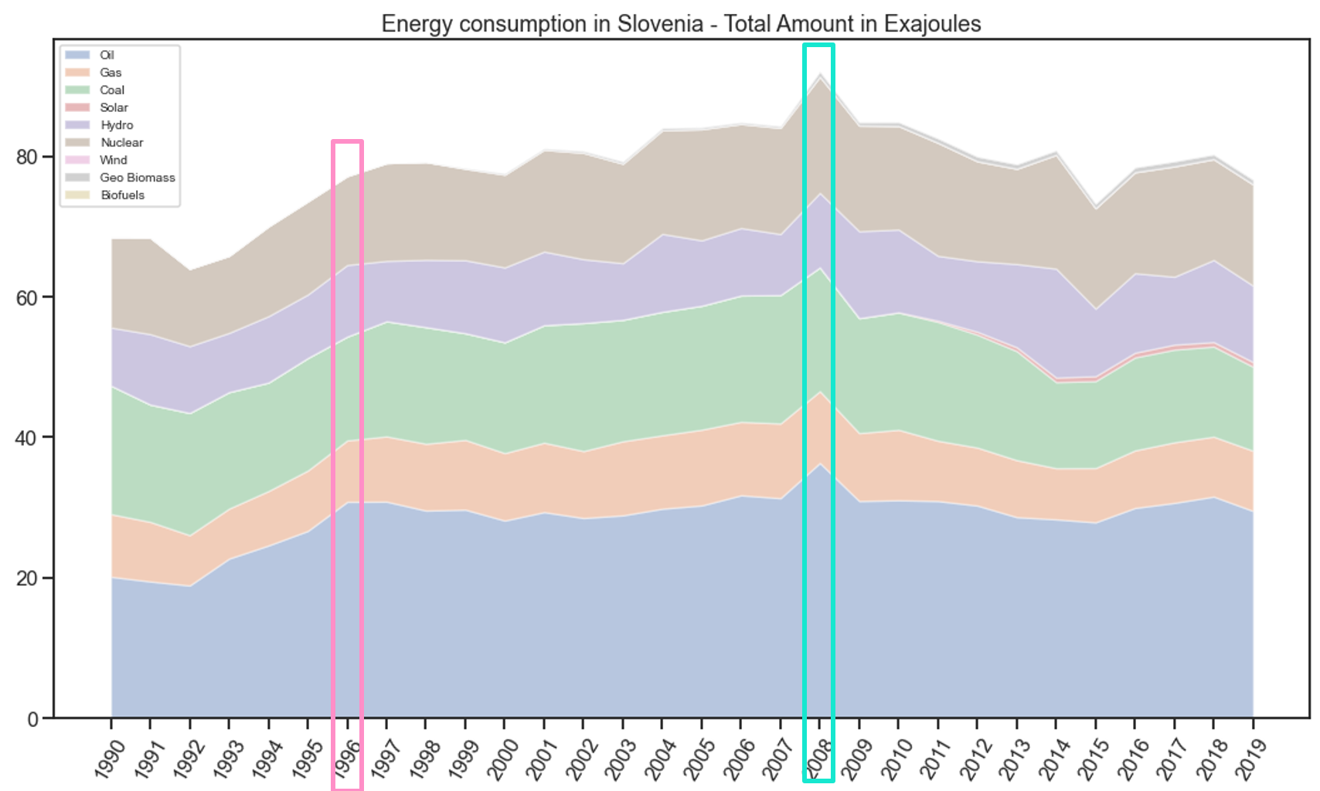
Energy Consumption by Source – Finland, Denmark and Slovenia
Year of Carbon Tax Implementation
Year of Highest CO2 emission

Slide 17
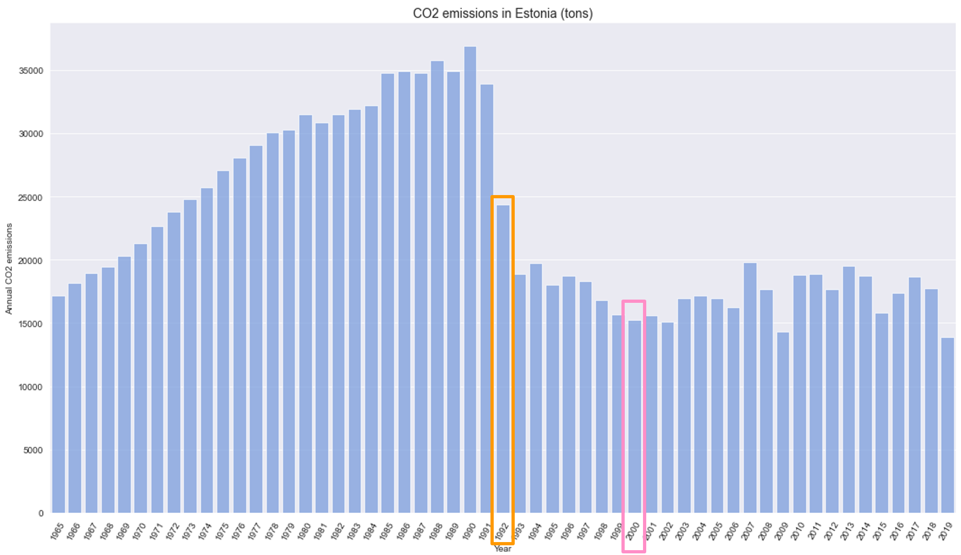
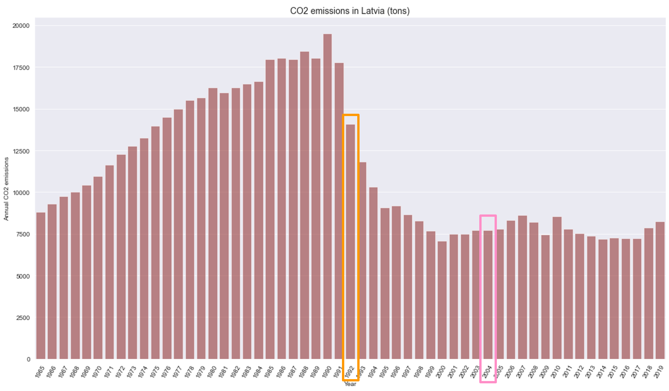
Strong decrease in CO2 emissions before Carbon Tax Implementation
Year of Carbon Tax Implementation
Year of Strong decrease in emission

Slide 18
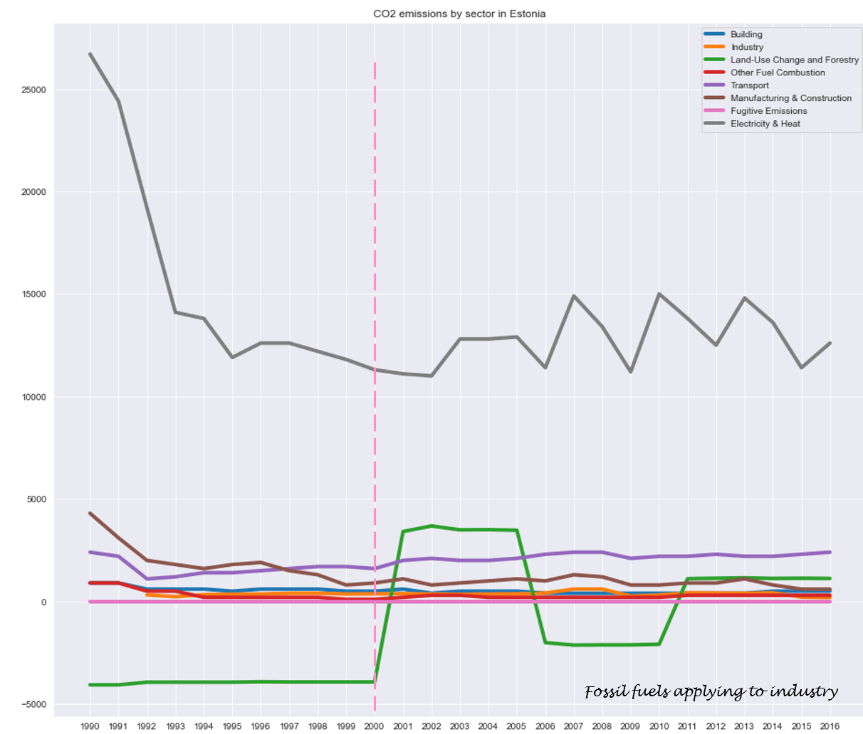
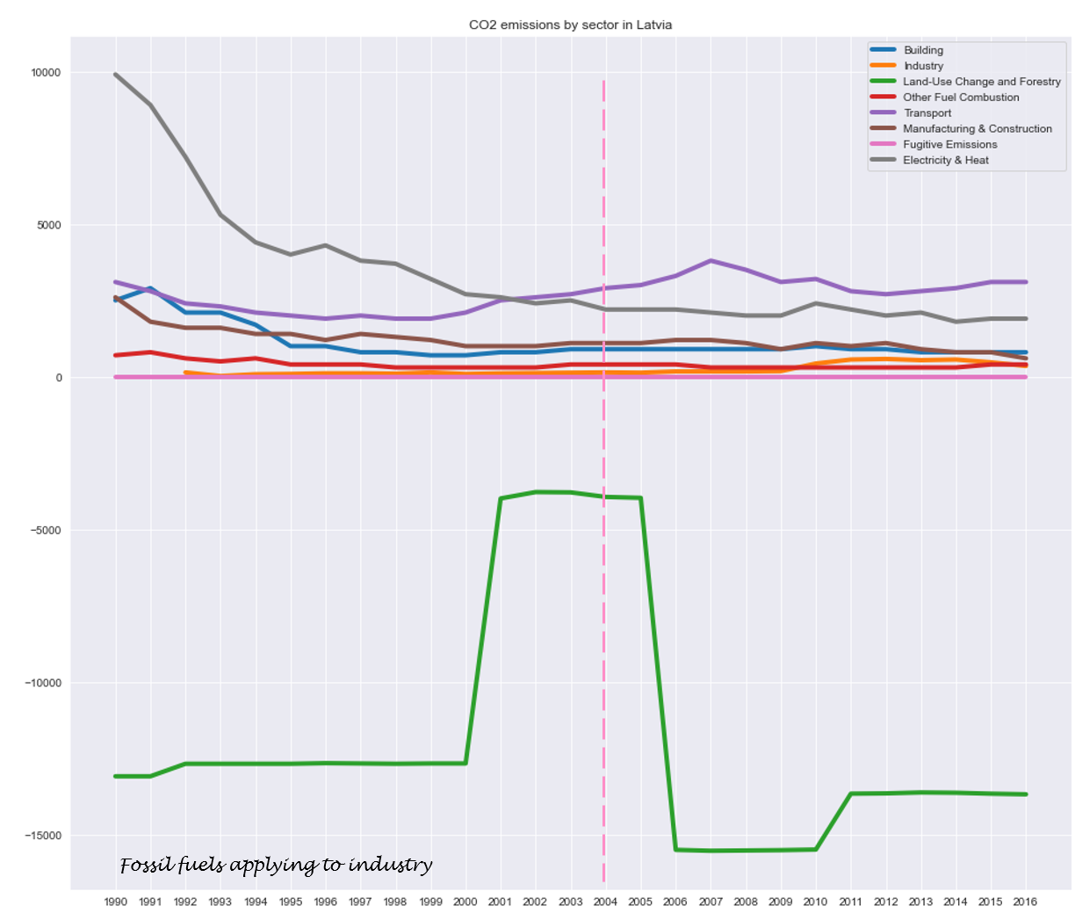
CO2 Emissions by Economic Sector

Slide 19
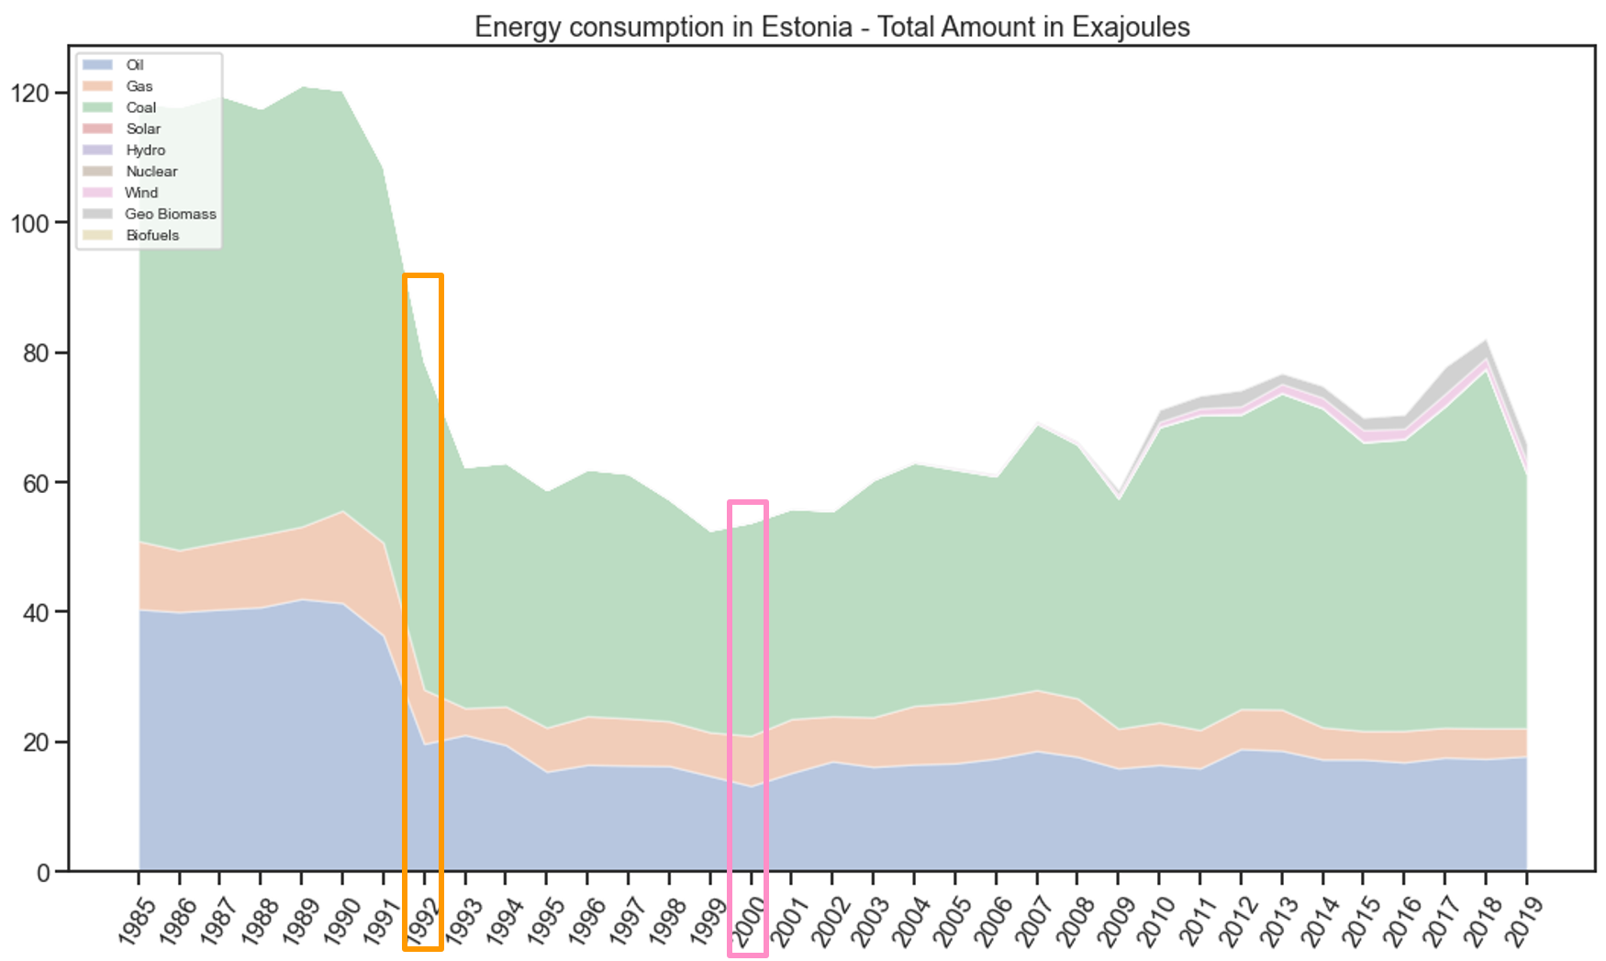
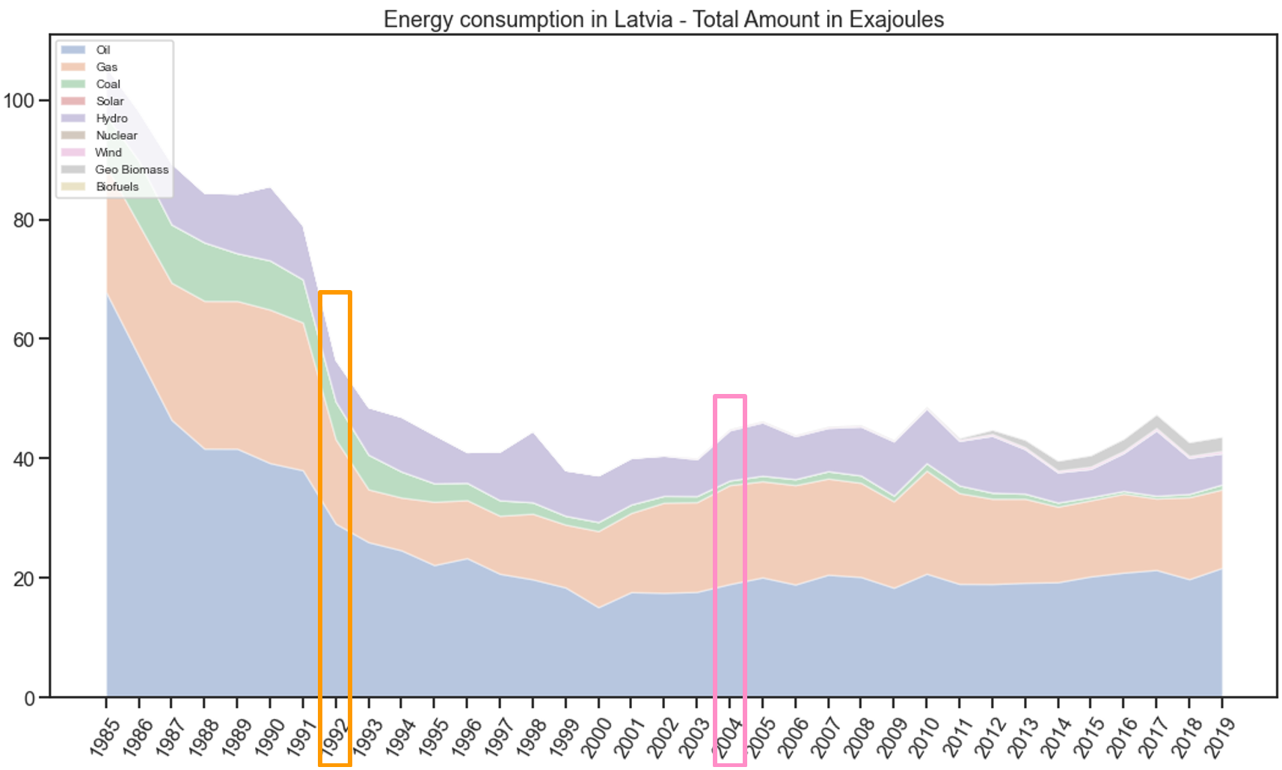
Energy Consumption by Source – Estonia and Latvia
Year of Carbon Tax Implementation
Year of Strong decrease in emission

Slide 20
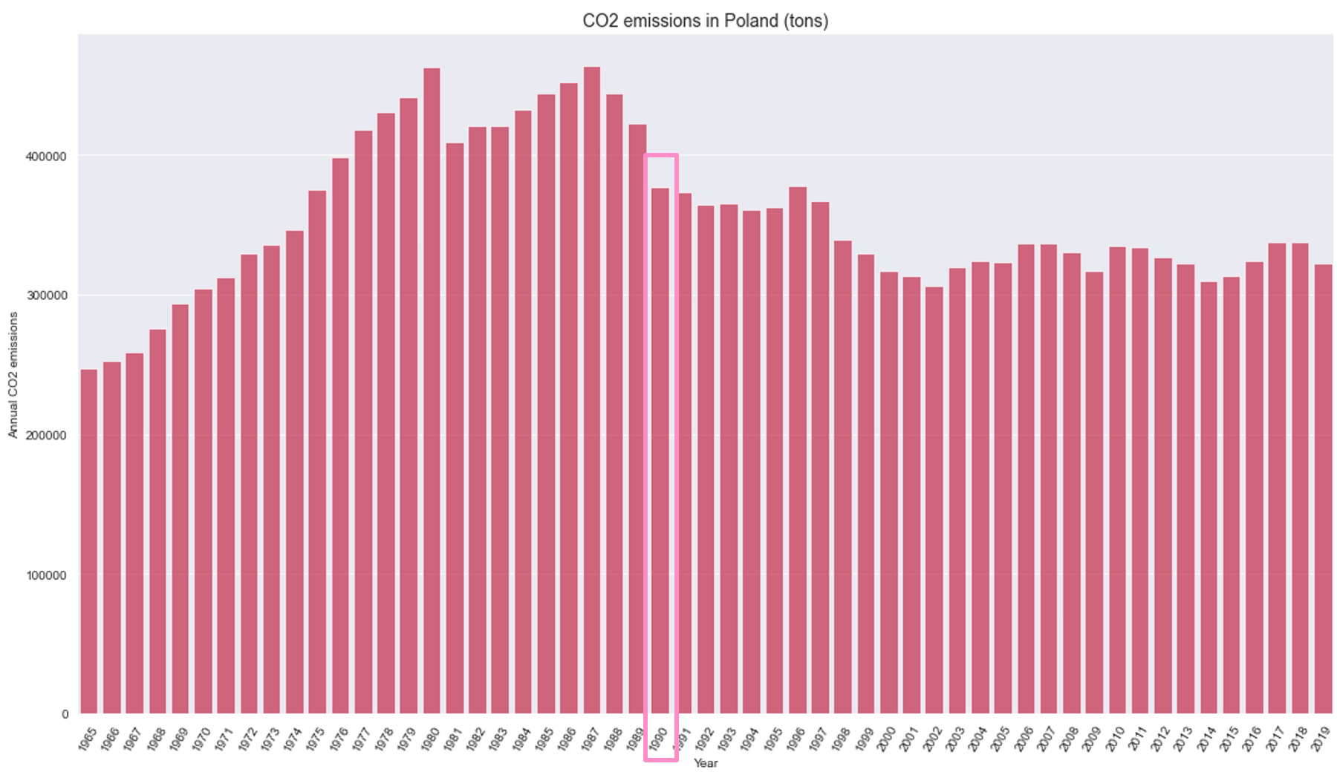
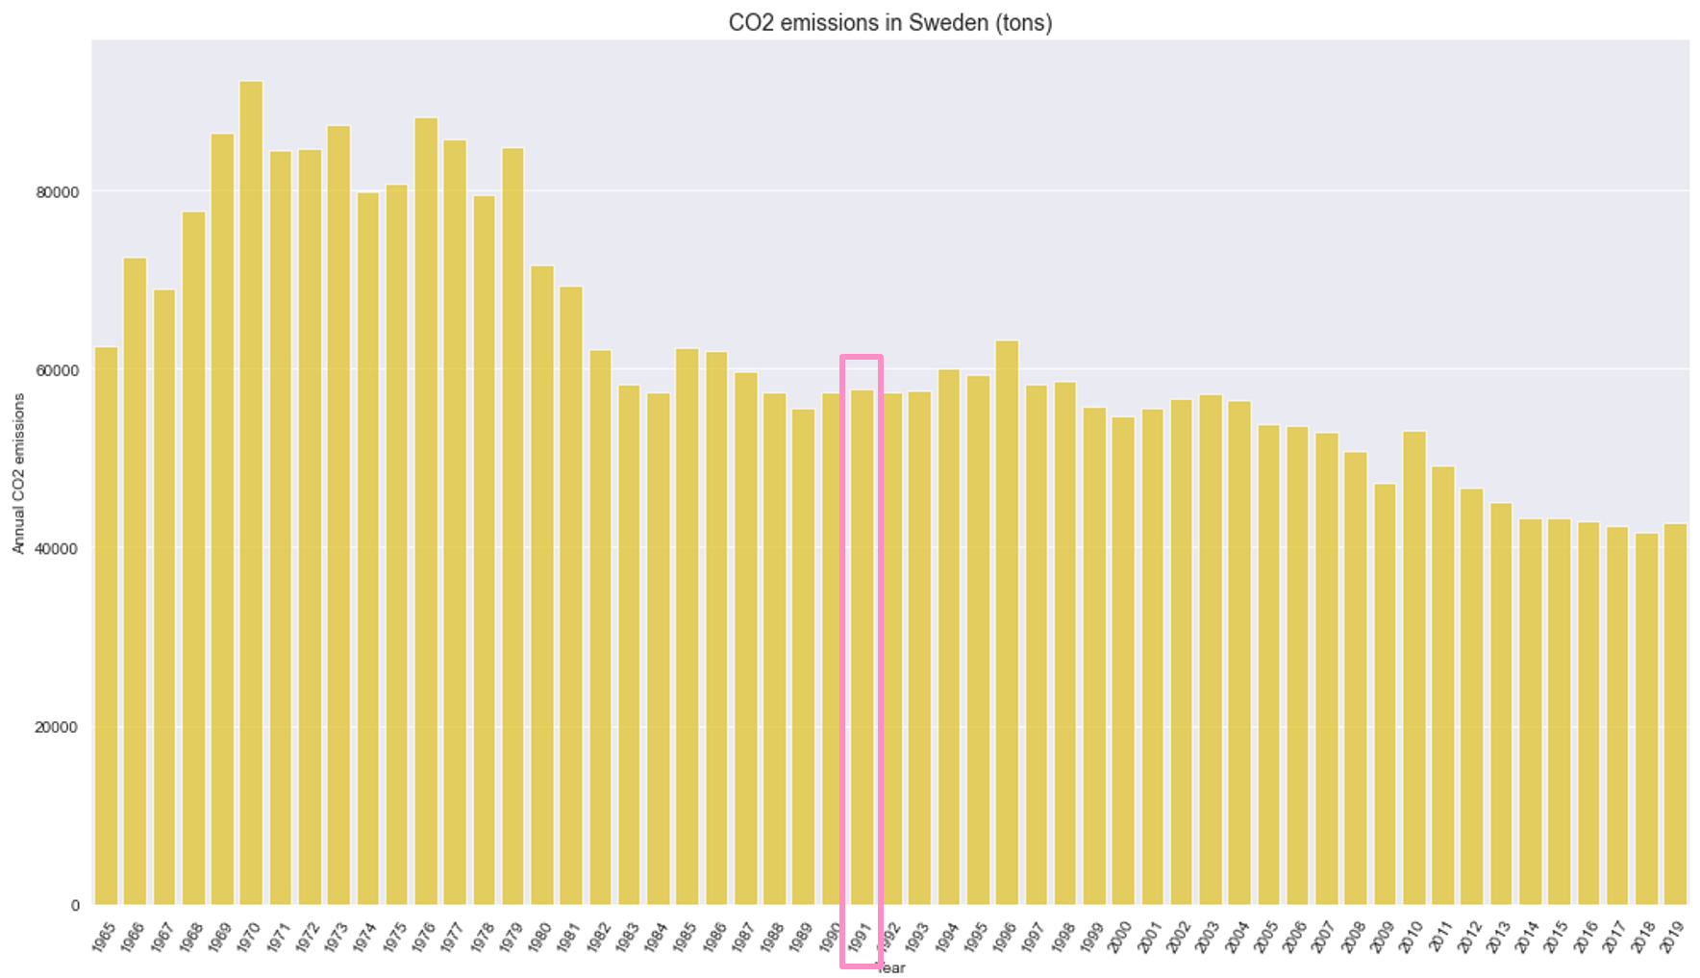
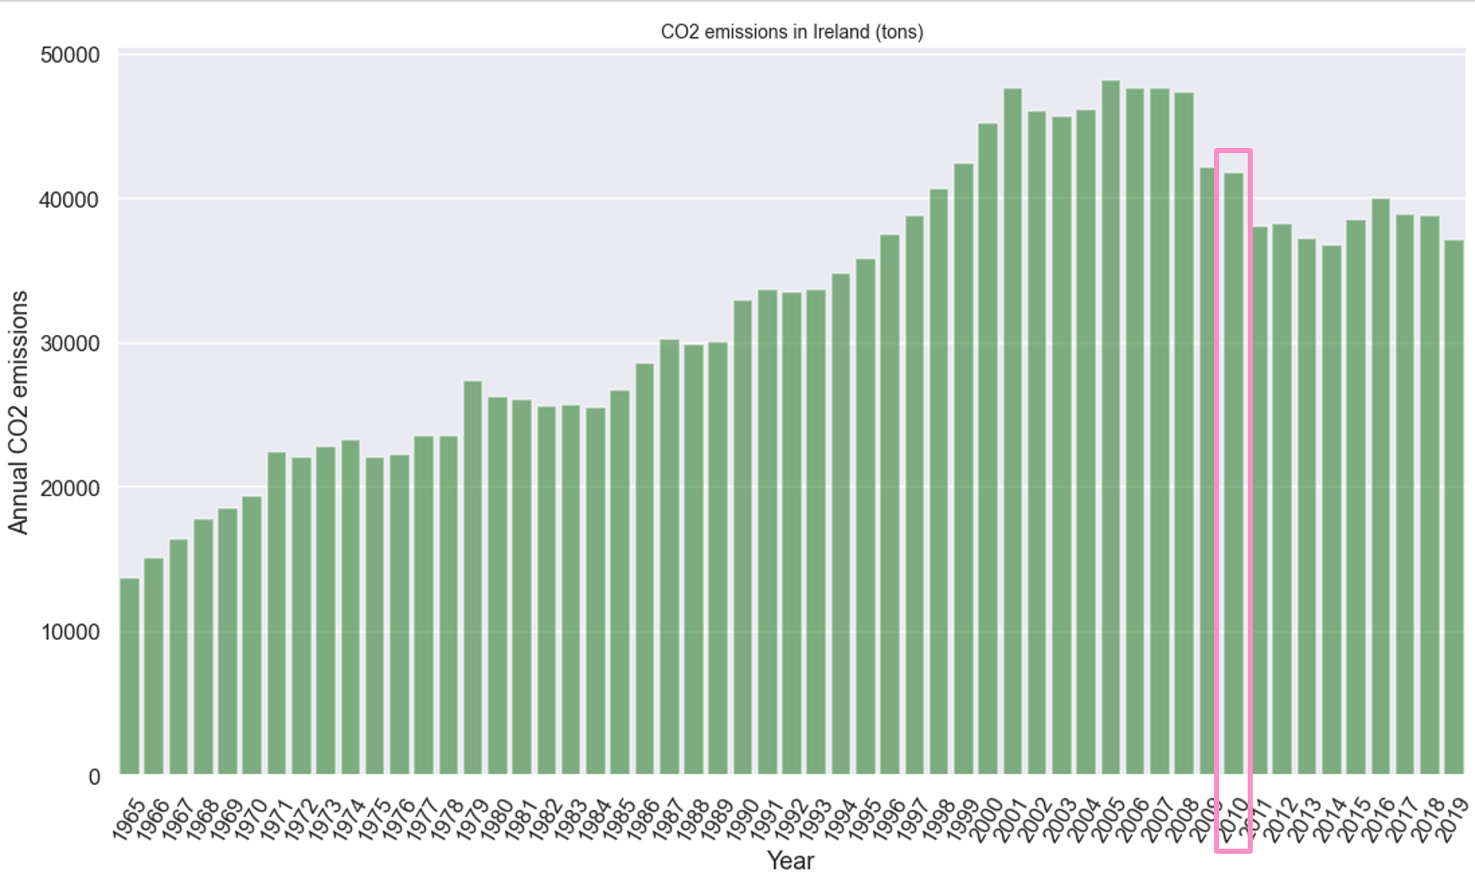
CO2 emissions almost stable after Carbon Tax Implementation
Year of Carbon Tax Implementation

Slide 21
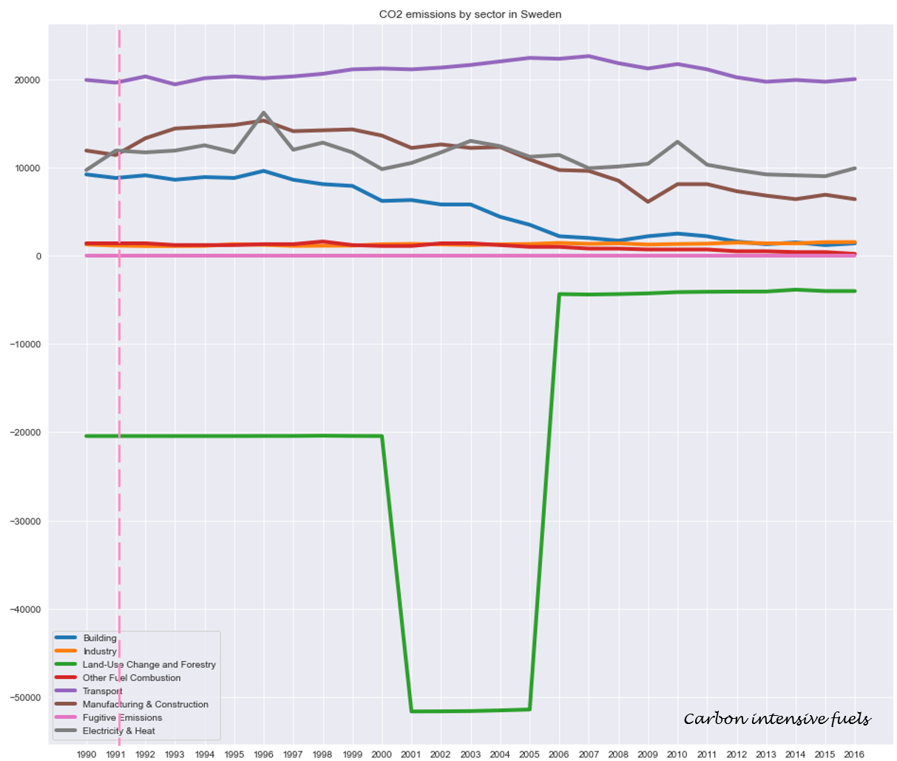
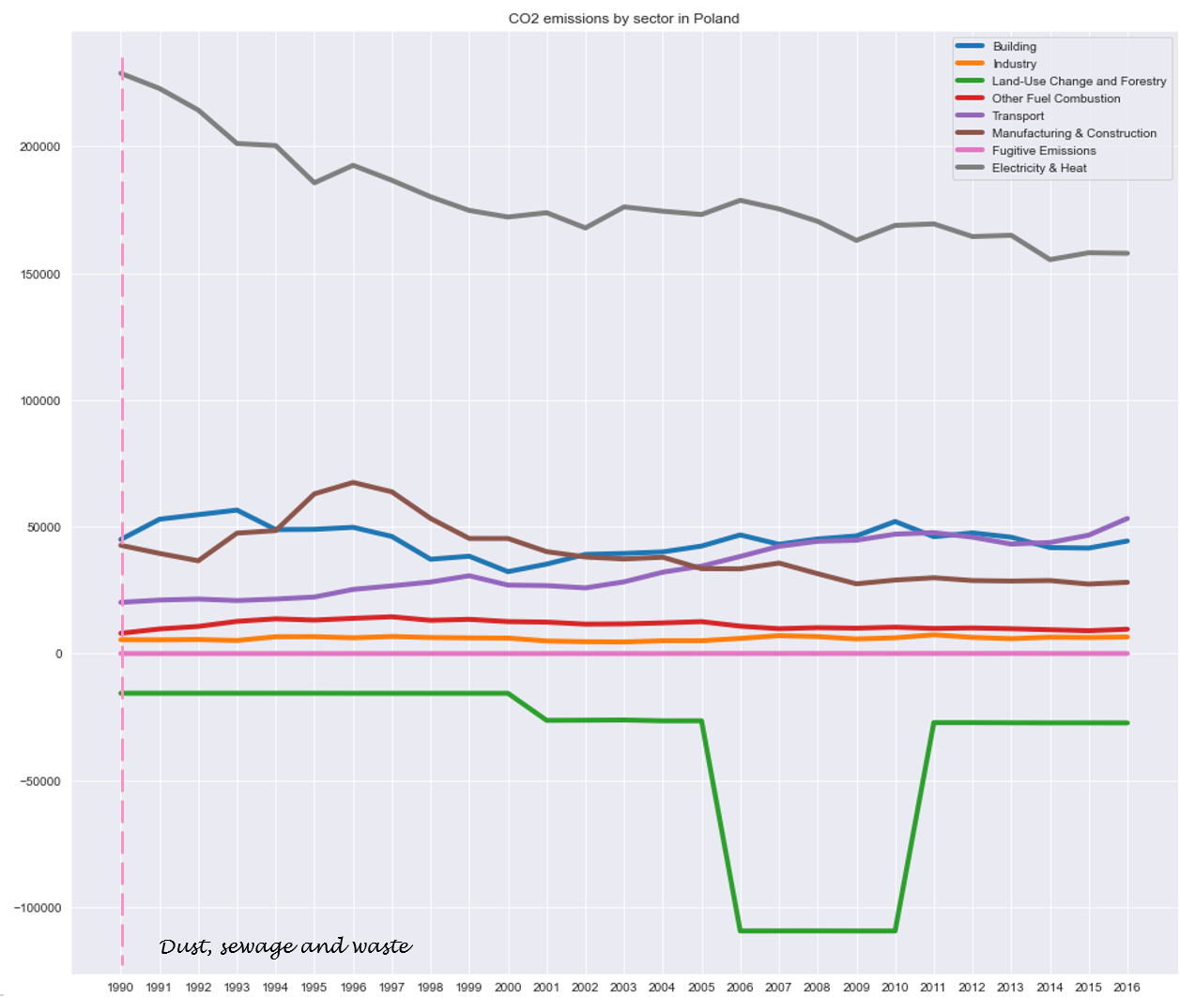
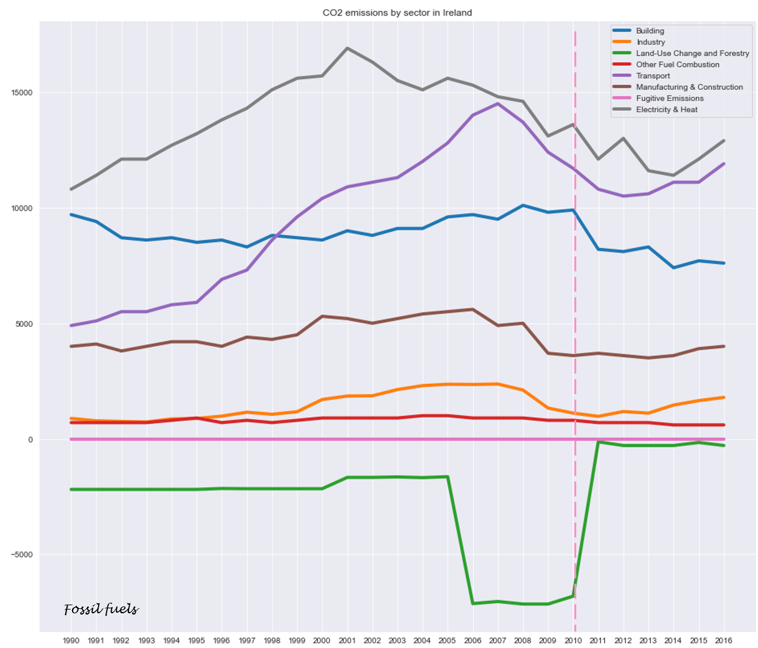
CO2 Emissions by Economic Sector

Slide 22
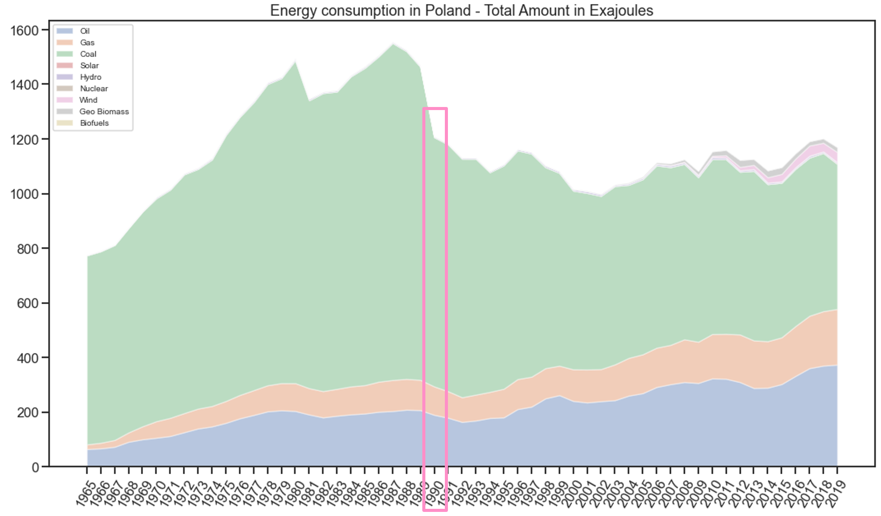
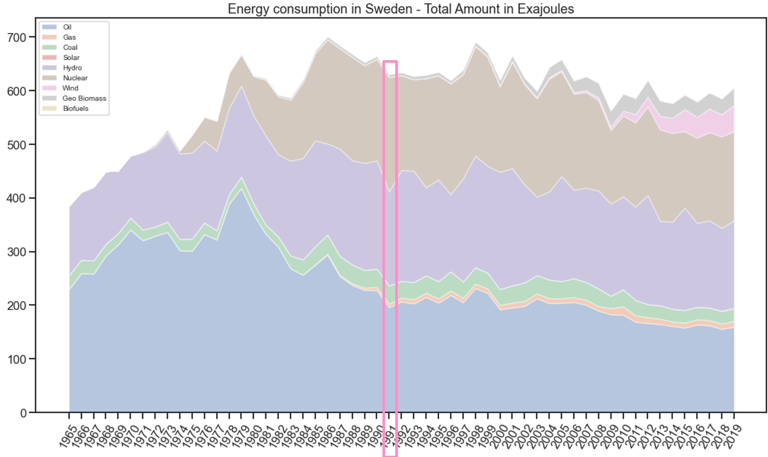
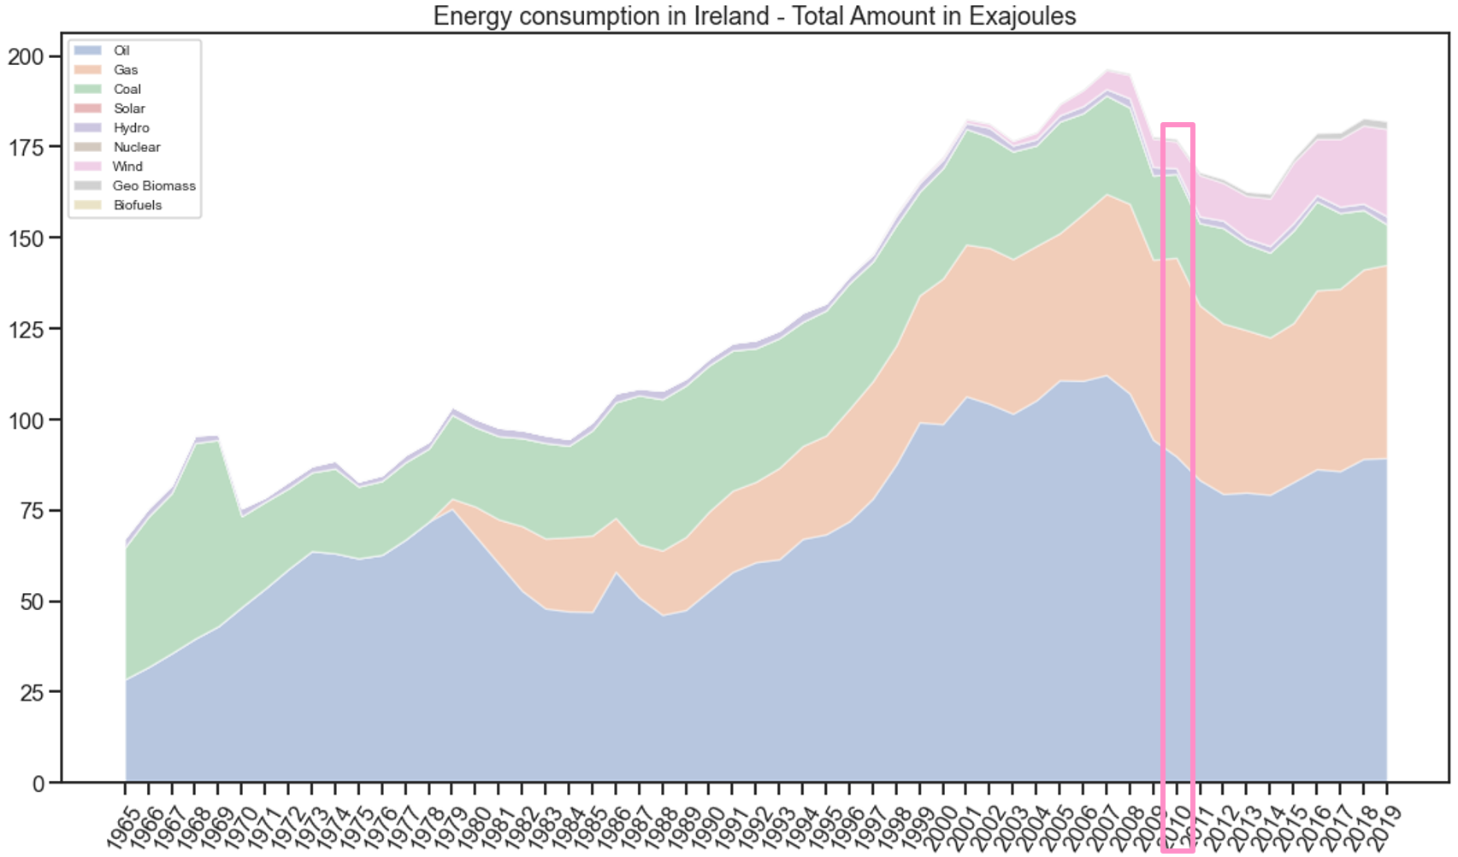
Energy Consumption by Source – Poland, Sweden and Ireland
Year of Carbon Tax Implementation

Slide 23
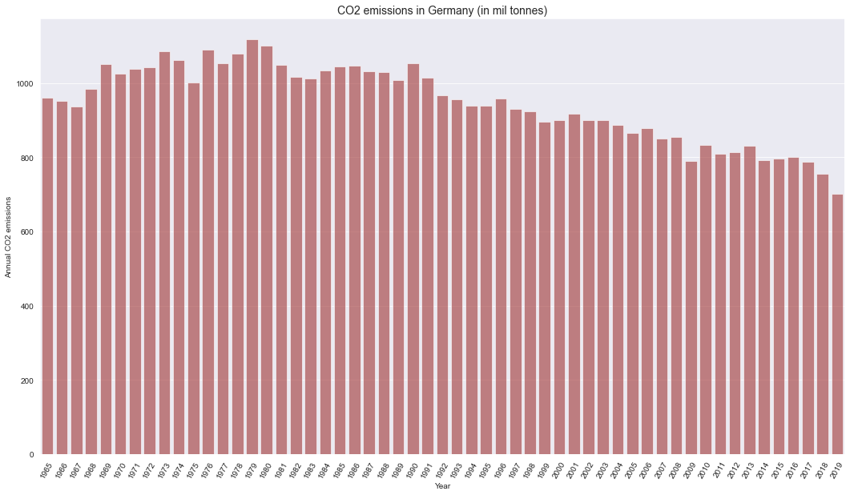
CO2 emissions in Germany

Slide 24
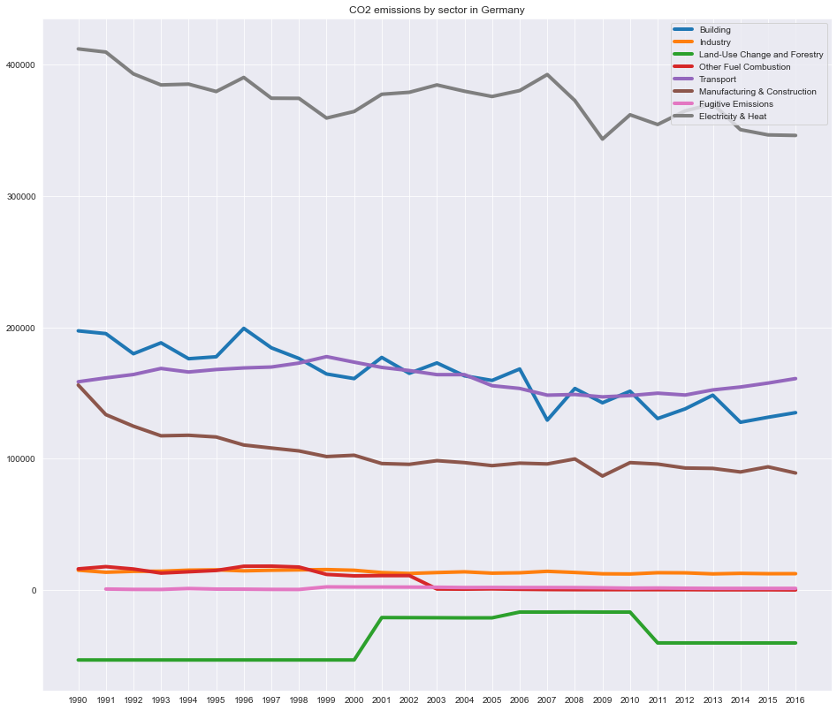
CO2 Emissions by Economic Sector

Slide 25
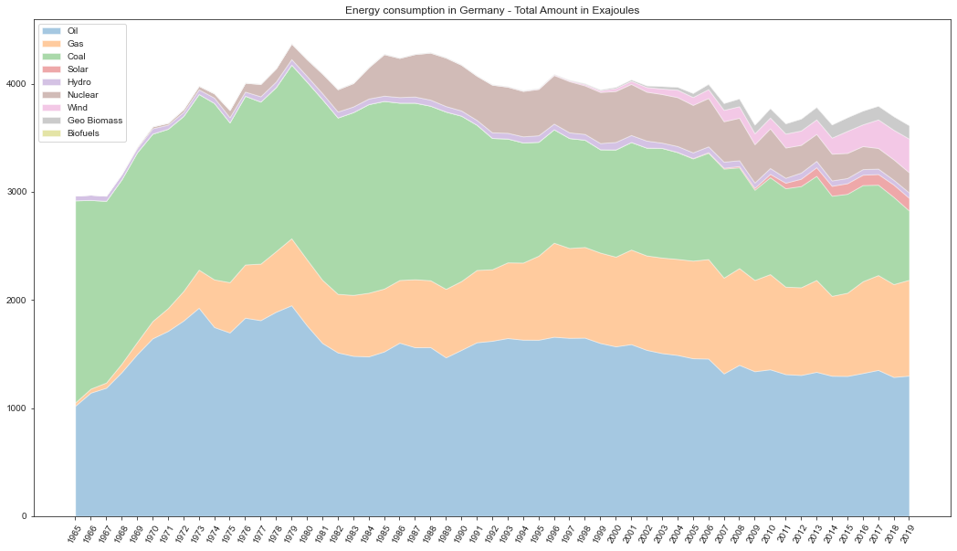
Energy Consumption by Source

Slide 26
Further question to think about:
How was the country’s GDP affected when emissions declined?
Which sectors received some kind of incentive?
Should be “penalize” more effective than “reward good practices”?
If the Carbon Tax cost more, CO2 emissions would decrease more?

Slide 27
FINAL MESSAGE

Slide 28

Let‘s use the tools that we have to help to save this place!
Image: https://eoimages.gsfc.nasa.gov/images/imagerecords/0/885/modis_wonderglobe_lrg.jpg

Slide 29
Thank you / Danke!
Liliani Lacerda
Data Science

